Slide 1
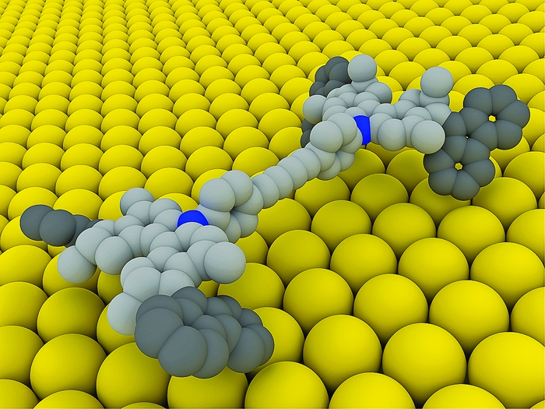
Nanobiotecnologia Curso 2018

Slide 2


Slide 3

Bionano, Nanobio…y todo eso
Nanotechnology is universally recognized as one of the most important scientific fields of the twenty-first century. Biomedical applications of this technology include nanobiotechnology and nanomedicine, one of seven emerging research areas highlighted by, and funded through, the NIH Roadmap for Medical Research. The advancement of this field relies on the combined efforts of researchers from many different backgrounds, including clinicians, biomedical engineers, materials scientists, applied physicists, and toxicologists. The need for a high-quality interdisciplinary review forum was pressing, and WIREs Nanomedicine and Nanobiotechnology looks to fill that niche. The topical coverage includes: Toxicology and regulatory issues; Implantable materials and surgical technologies; Diagnostic tools; Nanotechnology approaches to biology; Therapeutic approaches and drug discovery; Biology-inspired nanomaterials.
Bionanotechnology is a subset of nanotechnology where the biological world provides the inspiration and/or the end goal (Goodsell DS. 2004. Bionanotechnology: Lessons from Nature (pp. 1–8). New Jersey: Willey-Less.)
Nanobiotechnology is a multidisciplinary integration of nanotechnology, biotechnology, chemical processing, physical methodology, and systems engineering into biochips, molecular motors, nanocrystals, and nanobiomaterials (Klefenz H. 2004. Nanobiotechnology: from molecules to systems. Eng Life Sci 4: 211).

Slide 4
Nanobiotecnologia: situación de mercado

Slide 5
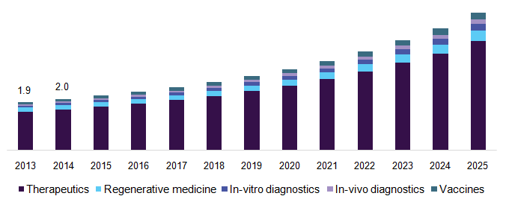
U.S. nanomedicine market by products, 2013 - 2025 (USD Billion)
USD 350.8 billion by 2025 (global)
The global biologics market generated a revenue of $238.8 billion in 2016. [monoclonal antibodies (MABs) and human insulin] biosimilar pathways
USD 138.8 billion (global)
Clinical cardiology is expected to witness the fastest growth through to 2025 owing to development in nano-functionalization and modification of surfaces for increased biocompatibility of implants in treatment of late thrombosis
https://www.grandviewresearch.com/industry-analysis/nanomedicine-market

Slide 6
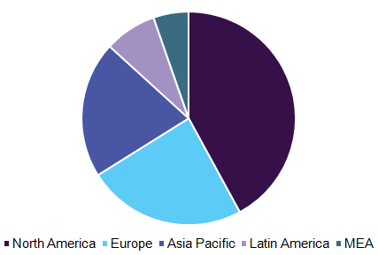
Nanomedicine market, by region, 2016 (%)
Asia Pacific is estimated to witness the fastest growth over the forecast period
Factors responsible include government and regulatory authorities that have implemented a framework to encourage R&D collaborations and framework extension.
https://www.grandviewresearch.com/industry-analysis/nanomedicine-market

Slide 7
Las tendencias mas importantes presenciadas por este segmento del Mercado son la creciente demanda de tecnologia de drug delivery, mayor participación gubernamental en subsidios I+D, aparición de recientes desarrollos tecnologicos en el area de las nanomedicinas y mayores oportunidades de crecimiento/inversion.
Leading Companies
Epeius Biotechnologies Corporation
Merck & Co Ltd
Teva Pharmaceutical Industries Ltd.
Abbott
Johnson & Johnson Services, Inc.
Bio-Gate AG
ABLYNX
Brigham and Women's Hospital (BWH)
Gilead
CytImmune Sciences Inc
Leadiant Biosciences, Inc.
Pfizer, Inc
Celgene Corporation
AMAG Pharmaceuticals
Nanospectra Biosciences, Inc.
https://www.businesswire.com/news/home/20171109006576/en/Global-Nanomedicine-Market-Analysis-Trends-2017-2025--

Slide 8

Development of nanotechnology-based medical devices enables major cost reduction across the medical device value chain, as it offers very high bargaining power to suppliers of medical device OEMs (original equipment manufacturers).
This research service (RS) analyzes the need for adoption of nanotechnologies in the medical devices industry, which are poised to enable creation of innovative medical device technologies that boost the overall quality of life for patients, and care providers. The RS evaluates the various technology developments within the major market segments within the global medical devices industry, such as drug delivery systems, in-vivo imaging, medical implants, and in-vitro diagnostics.
From a technology perspective, the research services covers an in-depth analysis of commercial applications of nanoscale materials, nanocoatings, biomimicking materials, nano-oncology applications, and development of nano-based surgical tools.
https://www.researchandmarkets.com/reports/3952444/nanotechnology-to-achieve-cost-efficiencies#relb1 2016

Slide 9
Nanobiotecnologia: productos y técnicas

Slide 10
FDA-approved nanomaterial-based drugs 2018
Agrahari,Vibhuti, Agrahari,Vivek, Facilitating the translation of nanomedicines to a clinical product: challenges and opportunities.Drug Discovery Today https://doi.org/10.1016/j.drudis.2018.01.047

Slide 11
FDA-approved nanomaterial-based drugs 2018 (cont)
Agrahari,Vibhuti, Agrahari,Vivek, Facilitating the translation of nanomedicines to a clinical product: challenges and opportunities.Drug Discovery Today https://doi.org/10.1016/j.drudis.2018.01.047

Slide 12
FDA-approved nanomaterial-based drugs 2018 (cont)
Agrahari,Vibhuti, Agrahari,Vivek, Facilitating the translation of nanomedicines to a clinical product: challenges and opportunities.Drug Discovery Today https://doi.org/10.1016/j.drudis.2018.01.047

Slide 13
(nano) medicina
Biologics: monoclonal antibody (mAbs), hormones, growth factors, fusion proteins, cytokines, therapeutic enzymes, vaccines, blood factors, and anticoagulants. The mAbs are the dominating other types in terms of sales and therapeutic enzymes is the highest growing type.
Macromolecule nanotherapeutics: approaches and challenges Puneet Tyagi Q1 z and Jose Luis SantosDrug Discovery Today Volume 00, Number 00 January 2018

Slide 14
Técnicas analíticas empleadas en la caracterización estructural de nanomateriales
Agrahari,Vibhuti, Agrahari,Vivek, Facilitating the translation of nanomedicines to a clinical product: challenges and opportunities.Drug Discovery Today https://doi.org/10.1016/j.drudis.2018.01.047

Slide 15
Técnicas analíticas empleadas en la caracterización estructural de nanomaterials
(cont)
Agrahari,Vibhuti, Agrahari,Vivek, Facilitating the translation of nanomedicines to a clinical product: challenges and opportunities.Drug Discovery Today https://doi.org/10.1016/j.drudis.2018.01.047

Slide 16
Técnicas analíticas empleadas en la caracterización estructural de nanomaterials
(cont)
Agrahari,Vibhuti, Agrahari,Vivek, Facilitating the translation of nanomedicines to a clinical product: challenges and opportunities.Drug Discovery Today https://doi.org/10.1016/j.drudis.2018.01.047

Slide 17
Técnicas analíticas empleadas en la caracterización estructural de nanomaterials
(cont)
Agrahari,Vibhuti, Agrahari,Vivek, Facilitating the translation of nanomedicines to a clinical product: challenges and opportunities.Drug Discovery Today https://doi.org/10.1016/j.drudis.2018.01.047

Slide 18
Nanobiotecnologia: nuevas propiedades materiales

Slide 19
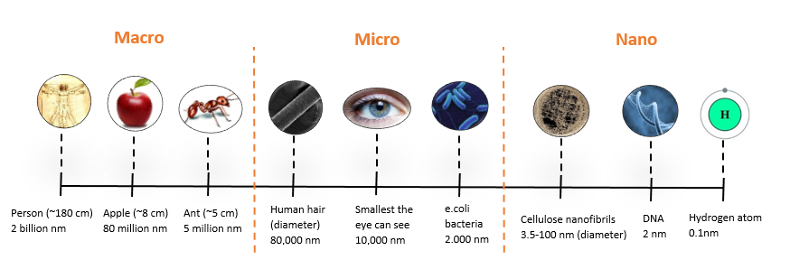
nanoescala:200/300-1 nm
1 nm= 10⁻⁹ m

Slide 20
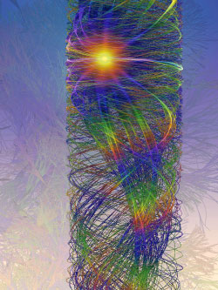
En la nanoescala ocurren nuevos fenómenos físicos y biológicos:
Computer simulation of electron motions within a nanowire that has a diameter in
the nanoscale range.
http://www.nano.gov/nanotech-101/special

Slide 21
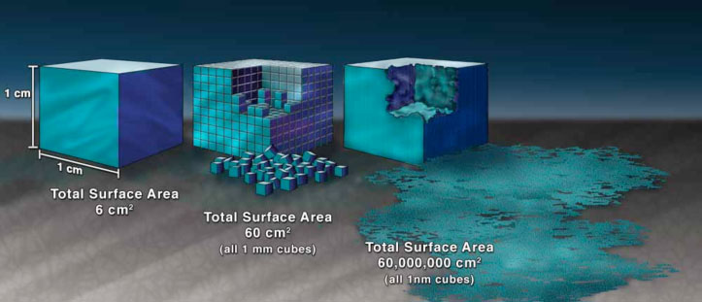
Propiedades de la nanoescala 1: ↑↑↑↑ área/volumen
Illustration demonstrating the effect of the increased surface area provided by nanostructured materials
http://www.nano.gov/nanotech-101/special

Slide 22

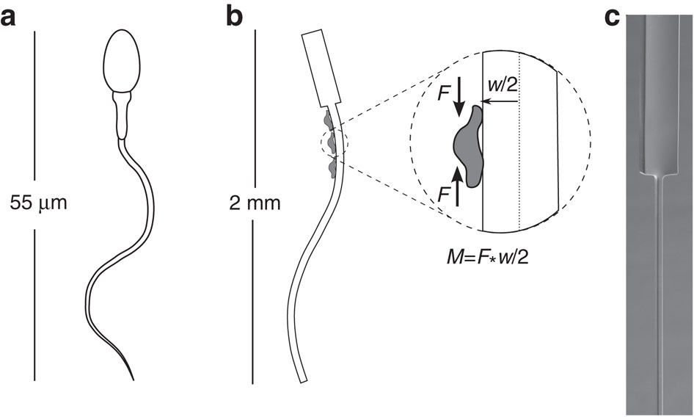
Nadar en la nanoescala= nadar en dulce de leche

Slide 23
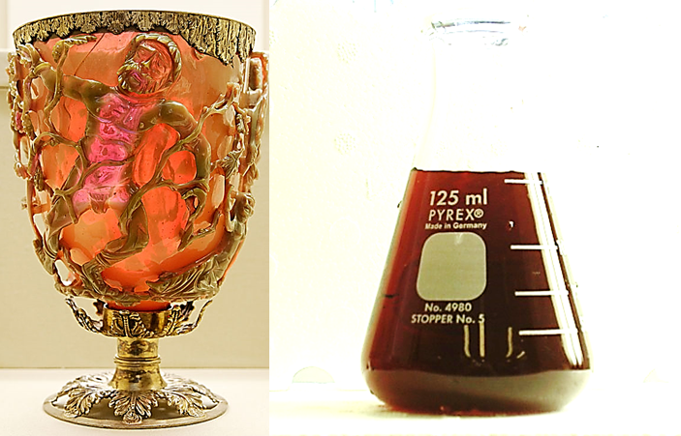
Propiedades de la nanoescala 2: nuevos fenómenos cuanticos
¡¡Cambio en las propiedades intensivas (punto de fusión, fluorescencia, conductividad eléctrica, permeabilidad magnética, reactividad química) en función del tamaño!!
Nanoparticulas de oro (Au)
http://www.nano.gov/nanotech-101/special

Slide 24
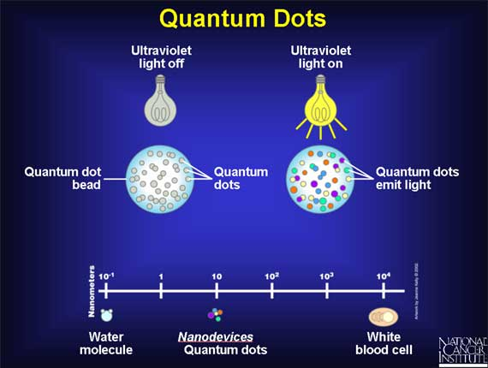
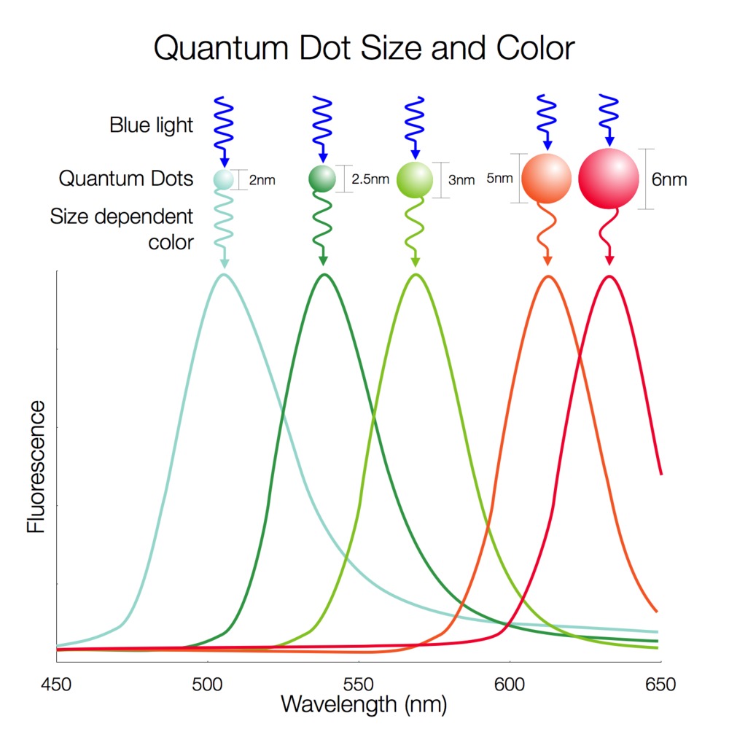
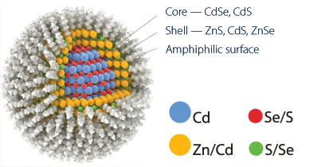

Slide 25
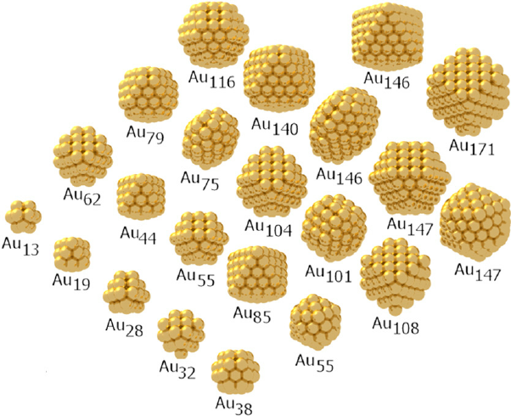
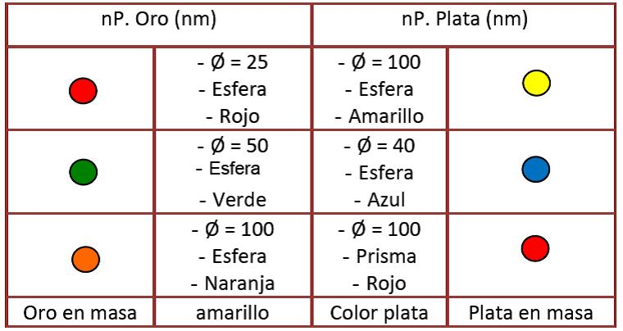
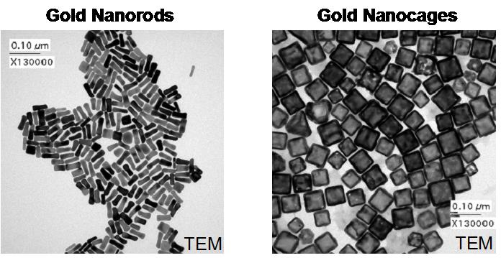
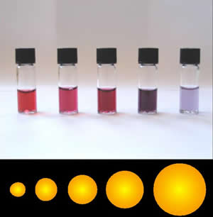
Propiedades de la nanoescala 2: el color depende del tamaño y forma
5 nm 90 nm

Slide 26
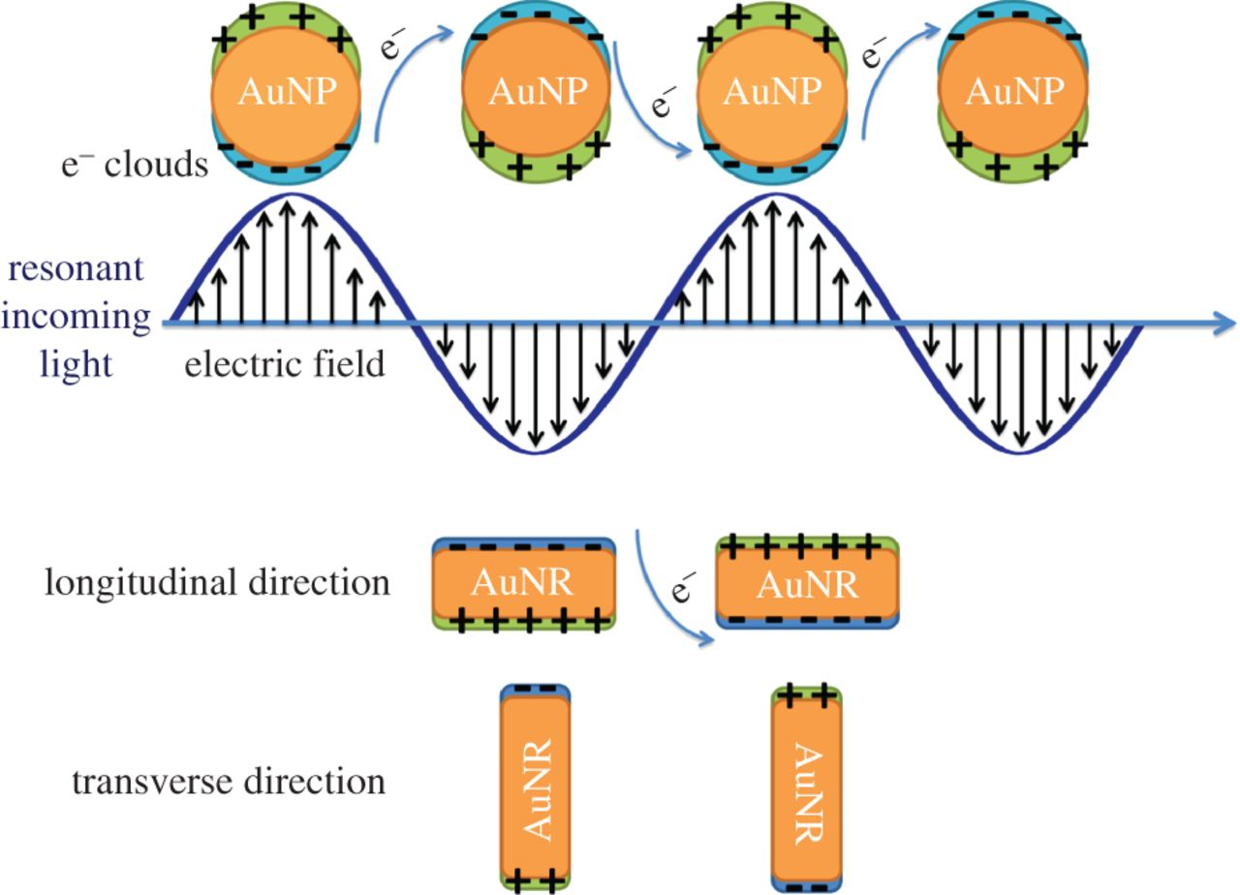
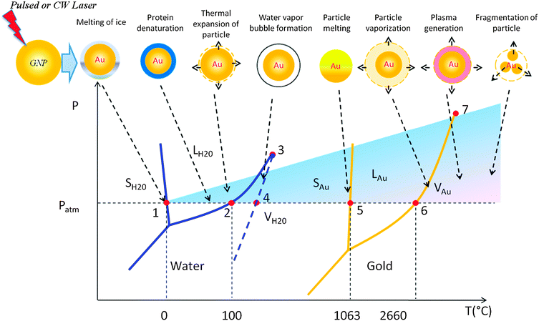
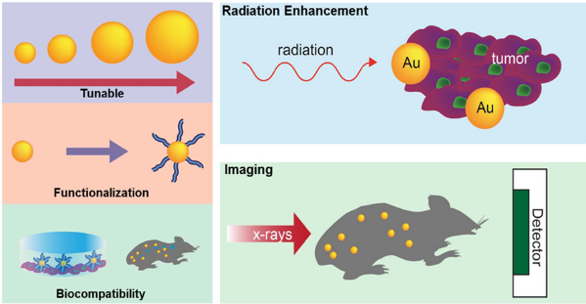
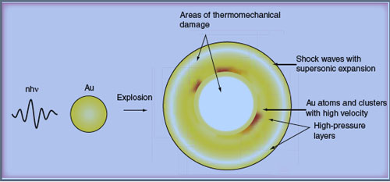
Propiedades de la nanoescala 2: nuevos fenómenos cuánticos: SPR Surface Plasmon Resonance

Slide 27
Jung Soo Suk, Qingguo Xu, Namho Kim, Justin Hanes, Laura
M. Ensign, PEGylation as a strategy for improving nanoparticle-based drug and gene
delivery, Advanced Drug Delivery Reviews (2015),
Efecto de la peguilacion
(B) PS-PEG NPs remained in systemic circulation, whereas
uncoated PS-COOH NPs accumulate in the liver.

Slide 28
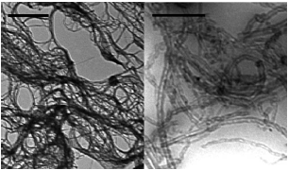
Nanotubos de carbono
Nanotubos C
Láminas de grafeno (sp²) que se enrollan sobre si mismas
SWCNT
TEM
MWCNT
monopared multipared
Gran AREA SUPERFICIAL SWCNT:
1000 m²/g
( C _{black} (micromaterial) 60-80 m²/g)
Gran RELACION DE ASPECTO (> 100)
1μm
250 nm
ESTABILIDAD MECÁNICA Y TÉRMICA
EXCELENTES CONDUCTORES TÈRMICOS y electricos (A LO LARGO DEL EJE: BALISTICOS)
AISLANTES ⊥ EJE
NANOCOMPOSITES ANISOTRÓPICOS
Biochimica et Biophysica Acta 1758 (2006) 404-412. Funcionalized carbon nanotubes as emerging nanovectors for the delivery of therapeutics. Cedric Klumpp, Kostas Kostarelos, Maurizio Prato, Alberto Bianco.
NTC 1μm
Liposoma 100 nm
PAMAM G5

Slide 29
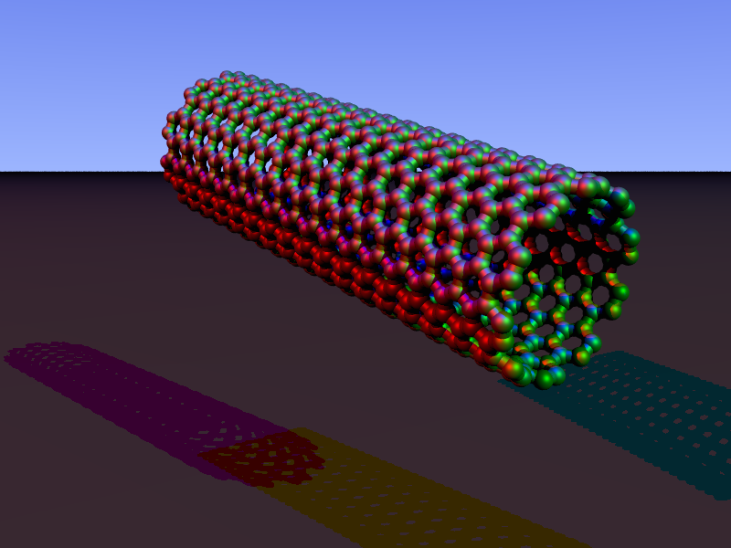
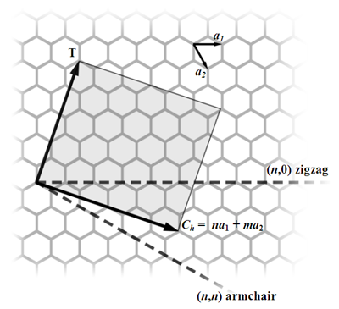
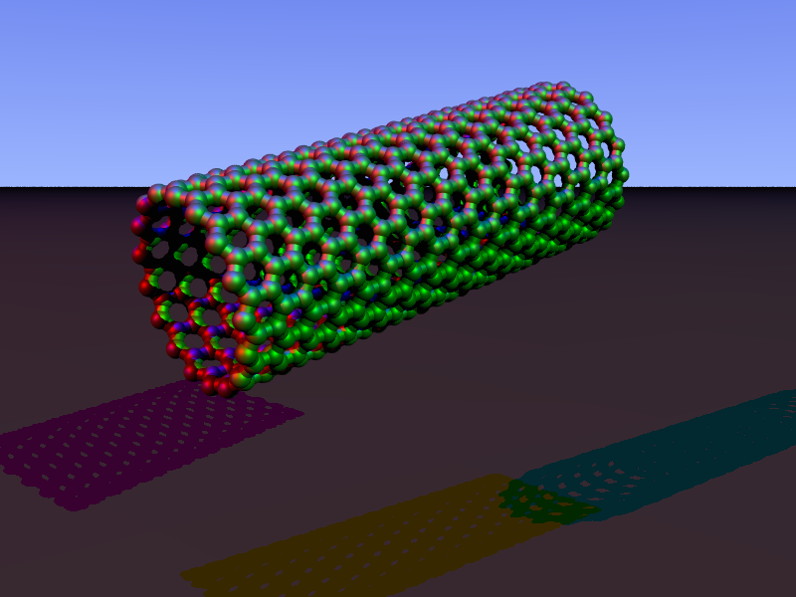
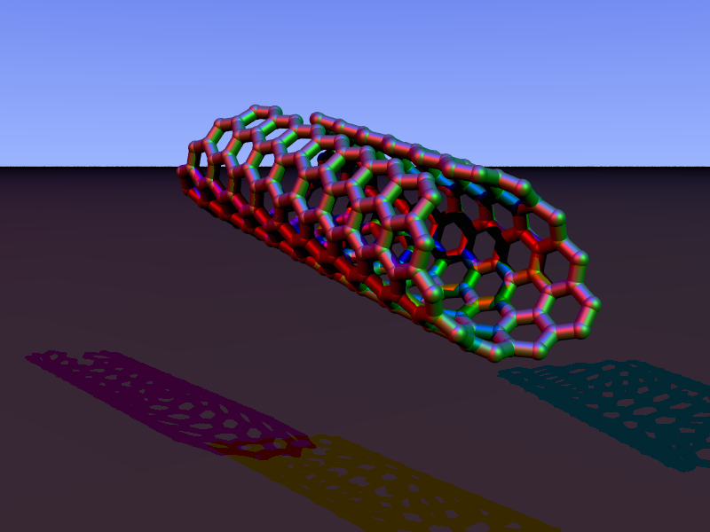
vectores unitarios del grafeno en espacio real
Eje tubo
Vector quiral Ch
n: átomos C alrededor circunferencia del tubo
m: átomos C hacia el eje del tubo
n = m
n , 0
n, m
Armchair
Zigzag
Quiral

Slide 30
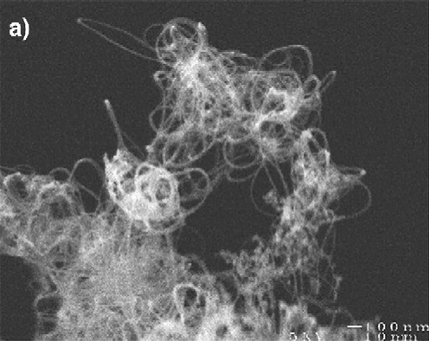
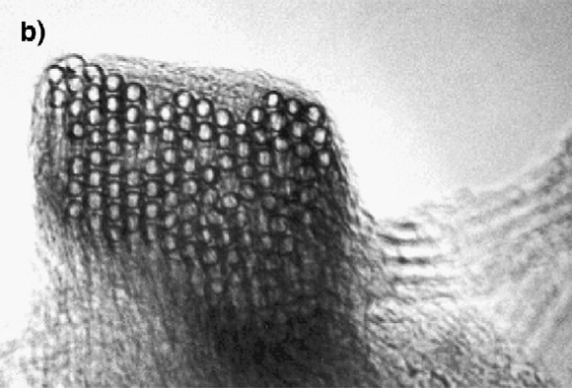
0,34 nm
2-100 nm
Ambos 1-50 μm longitud
0,4-2 nm
manojos monodispersos
Extremos cerrados
Extremos abiertos muy reactivos
MÉTODOS DE PREPARACIÓN: i) descarga de arco, ii) ablación láser
iii) deposición química de vapor: reacción de gas (acetileno, etileno, etanol) que contiene C junto a partículas metálicas catalíticas (Co, Ni, Fe) a T > 600 °C
HiPCO (high pressure CO conversion) fácilmente escalable, pocas impurezas (30 % Ni, Fe, C amorfo, nanopartículas residuales) obligatoriamente removidas
SEM image of a SWNT bundles
TEM image of a SWNT bundles
PURIFICACIÓN: oxidación H+ fuertes
Puede cortar nanotubos y generar –COOH
GPC, centrifugación, filtración cromatografía
PRÁCTICAMENTE INSOLUBLES EN TODO SOLVENTE
EXIGEN MODIFICACIONES SUPERFICIALES PARA DISPERSARSE EN SOLVENTES ACUOSOS
The role of surfactants in dispersion of carbon nanotubes Linda Vaisman , H. Daniel Wagner , Gad Marom Advances in Colloid and Interface Science 128–130 (2006) 37–46

Slide 31
Yi Zhang Yuhong Bai and Bing Yan Functionalized carbon nanotubes for potential medicinal applications Drug Discovery Today Volume 15, Numbers 11/12 June 2010
Usos terapéuticos?
SWNT can absorb NIR radiation energy and cause local heating, which can lead to HeLa cell destruction. (a) Temperature evolution of a DNA-SWNT solution (approximately 25 mg/l) during continuous radiation by an 808 nm laser at 1.4 W/cm2 for two minutes. (b) Image of HeLa cells without internalized SWNTs after continuous 808 nm laser radiation at 3.5 W/cm2 for 5 min. No cell death was observed. (c) Image of dead and aggregated cells after internalization of DNA-SWNT and laser radiation at 1.4 W/cm2 for 2 min. The dead cells showed rounded and aggregated. Reproduced, with permission, from Ref. [49]. Copyright 2005 National Academy of Sciences, USA.

Slide 32
Pulmonary toxicity of carbon nanotubes: a systematic report Jitendra Kayat, MPharm, Virendra Gajbhiye, MPharm, Rakesh Kumar Tekade, MPharm, Narendra Kumar Jain, PhD⁎Nanomedicine: Nanotechnology, Biology, and Medicine xx (2010) xxx–xxx

Slide 33
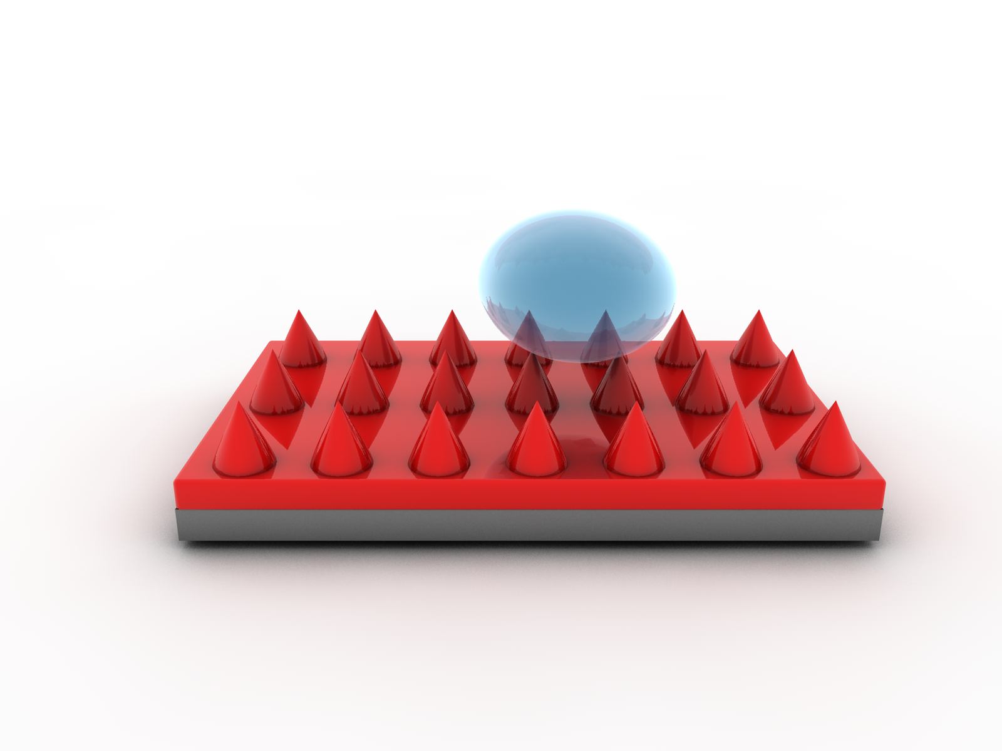
Control de la materia en la nanoescala (propiedades mnanoescala 3): efecto loto/superficies hidrofobicas

Slide 34
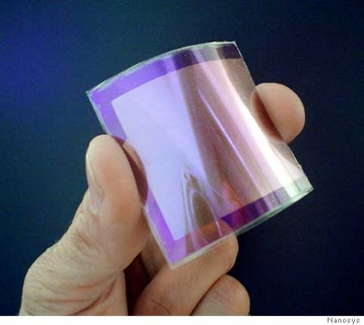
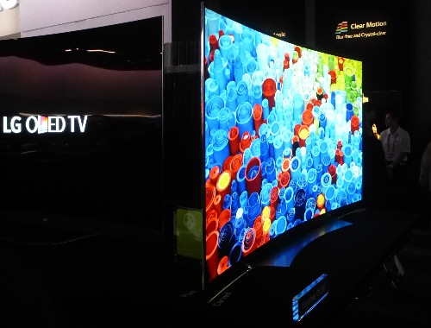
Vida diaria
Electrónica y TICs: dispositivos mas veloces, pequeños, portátiles, con mayor memoria y capacidades
Nanotransistores
Magnetic random access memory (MRAM): salvado eficiente y veloz de datos encriptados frente a desconexion o accidentes.
Films polimericos nanoestructurados= organic light-emitting diodes (OLEDs): imágenes planas mas brillantes, mayor angulo de vision, liviandad, mayor densidad, menor consumo, mayor vida media.
Energía sustentable: mas limpia, barata, de fuentes renovables/procesos menor consumo energetico y menor impacto ambiental
Paneles solares impresos, flexibles…pintables
Nanocatalizadores
Nanobaterias
Remediación ambiental: detección de impurezas/filtración-purificación de agua
Remoción de bacterias y virus/desalinizacion
Uso de self-assembled monolayers on mesoporous supports (SAMMS™), dendrimeros, CNT en detoxificacion ambiental/filtros
Salud
nanotecnologia

Slide 35
RETOS a supercar en el desarrollo y comercializacion de productos nanomedicos/nanobiotecnologicos
Agrahari,Vibhuti, Agrahari,Vivek, Facilitating the translation of nanomedicines to a clinical product: challenges and opportunities.Drug Discovery Today https://doi.org/10.1016/j.drudis.2018.01.047

Slide 36
Schematic representation of the process of nanomedicine development
Agrahari,Vibhuti, Agrahari,Vivek, Facilitating the translation of nanomedicines to a clinical product: challenges and opportunities.Drug Discovery Today https://doi.org/10.1016/j.drudis.2018.01.047

Slide 37
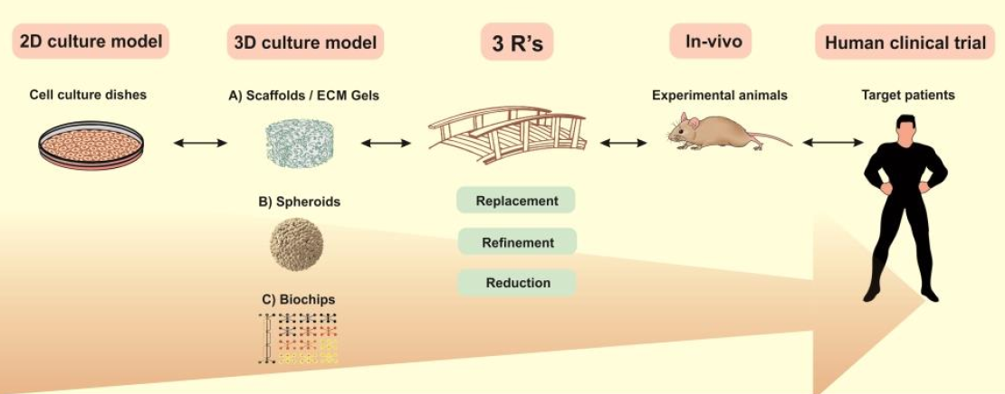


Etapas en el desarrollo de medicamentos
Etapas Pre-clinicas
Etapas clínicas
Modelos 3D
Reemplazo
Reduccion
Refinamiento
Tests in vitro
Tests in vivo
Russell and Burch 1959: ‘Principles of Humane Experimental Technique’ [27]
falla
falla
3D+3R
a mere 10% improvement in preclinical screening methods would reduce drug development costs by 100 million dollars per drug approved to the market (I. Cavero, Optimizing the preclinical/clinical interface: an Informa Life Sciences conference 12-13 December, 2006, London, UK, Expert opinion on drug safety, 6 (2007) 217-224)
Life in 3D is Never Flat: 3D Models to Optimise Drug Delivery Kathleen A. Fitzgerald, Meenakshi Malhotra, Caroline M. Curtin, Fergal J. O’ Brien, Caitriona M. O’ DriscollJournal of Controlled Release (2015)

Slide 38
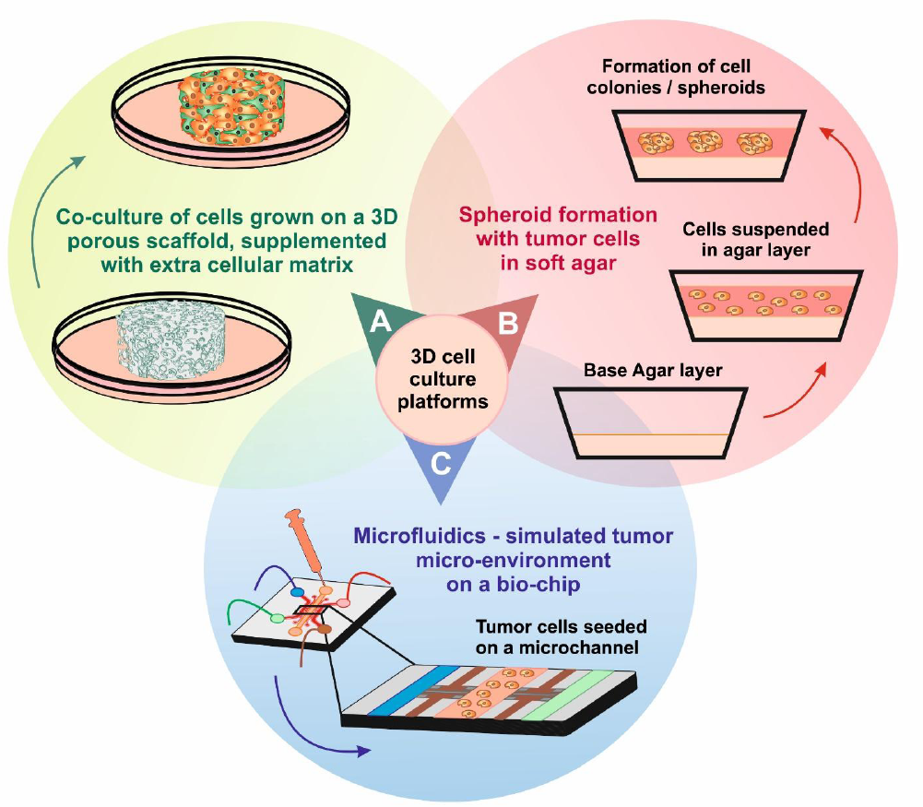
Metodos de cultivos 3D en el labo
Diferentes tipos celulares
Interior necrotico
Flujo dinamico
Life in 3D is Never Flat: 3D Models to Optimise Drug Delivery Kathleen A. Fitzgerald, Meenakshi Malhotra, Caroline M. Curtin, Fergal J. O’ Brien, Caitriona M. O’ DriscollJournal of Controlled Release (2015)

Slide 39
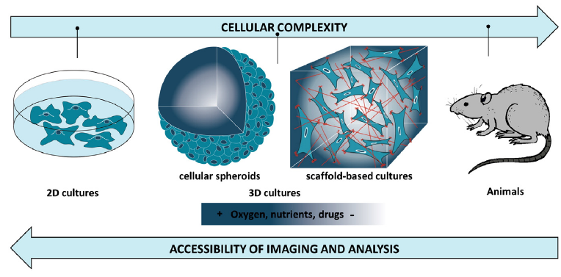
Fig. 4. Rethinking drug screening processes. Tissue engineering provides 3D cultures that recreate the complex cellular microenvironmentmore precisely than traditional 2D cultures, due to the incorporation ofmultiple physical,mechanical and chemical cues that arise fromECM–cell and cell–cell interactions. At the opposite end of the experimental continuum, animals do not capture important facets of human behavior and they are not feasible for HTS applications. Therefore, 3D cultures can bridge the gap between 2D cultures and animal models.

Slide 40
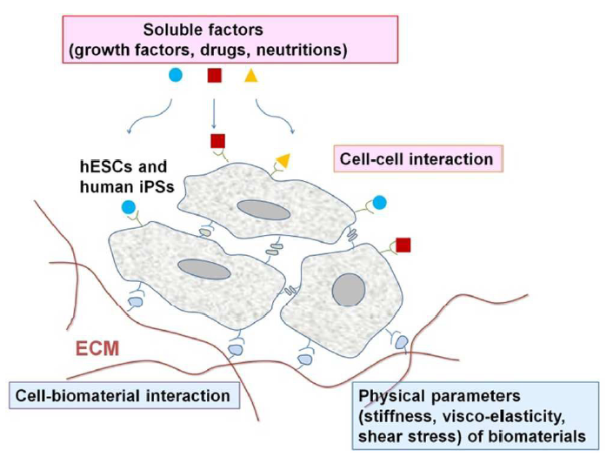
Las células son sensibles a su microentorno!
Several factors in the microenvironments of stem cells influence their fate:
soluble factors
cell-cell interactions
cell biomacromolecule (or biomaterial) interactions
physical factors, such as (a) the concentration of oxygen (e.g., hypoxia condition) (b) the elasticity (rigidity) of cell culture matrices (biomaterials), (c) the topographies of cell culture biomaterials, and (d) the mechanical forces produced by cell culture biomaterials
Cicada-inspired cell-instructive nanopatterned arrays Ting Diu1,2, Nilofar Faruqui1 , Terje Sjo¨stro¨m2 , Baptiste Lamarre1 , Howard F. Jenkinson2 , Bo Su2 & Maxim G. Ryadnov1,3: Diu, T.et al. Cicada-inspired cell-instructive nanopatterned arrays. Sci. Rep. 4, 7122; (2014).

Slide 41
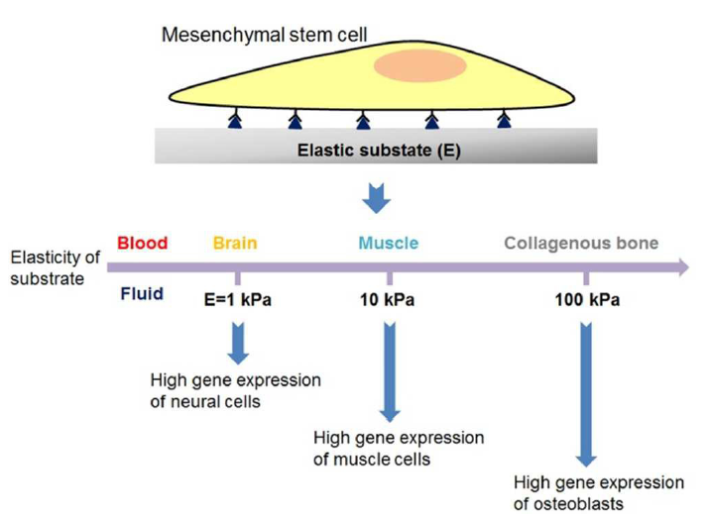
La elasticidad de MEC (prop. física) determina la expresión genética de células en cultivo!!
A. Higuchi, Q. Ling, S. S. Kumar, Y. Chang, A. A. Alarfaj, M. A. Munusamy, K. Murugan, S. Hsu and A. Umezawa, Physical cues of cell culture materials lead the direction of differentiation lineages of pluripotent stem cells J. Mater. Chem. B, 2015,

Slide 42
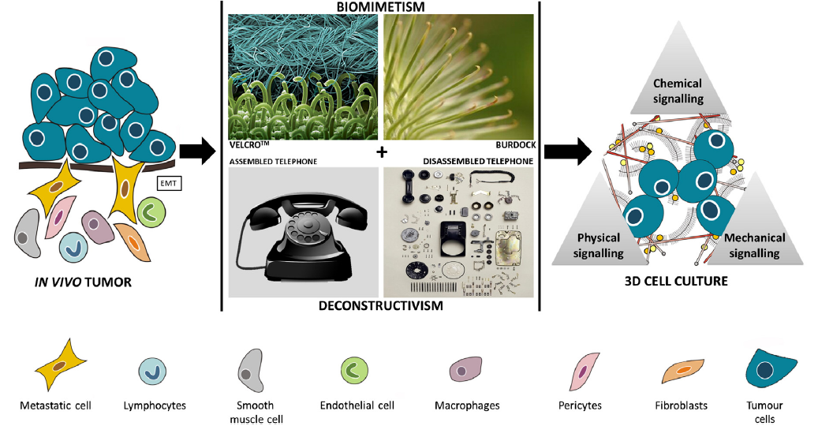
Bioingenieria: Principios de diseño 3D: Biomimetismo (ideas de la naturaleza) + deconstructivismo (simpler more predictable)
Bioengineering 3D environments for cancer models. Mireia Alemany-Ribes, Carlos E. SeminoAdvanced Drug Delivery Reviews xxx (2014) xxx–xxx

Slide 43
Metodos de cultivos 3D en el labo
Diferentes tipos celulares
Interior necrotico
Flujo dinamico
Life in 3D is Never Flat: 3D Models to Optimise Drug Delivery Kathleen A. Fitzgerald, Meenakshi Malhotra, Caroline M. Curtin, Fergal J. O’ Brien, Caitriona M. O’ DriscollJournal of Controlled Release (2015)

Slide 44
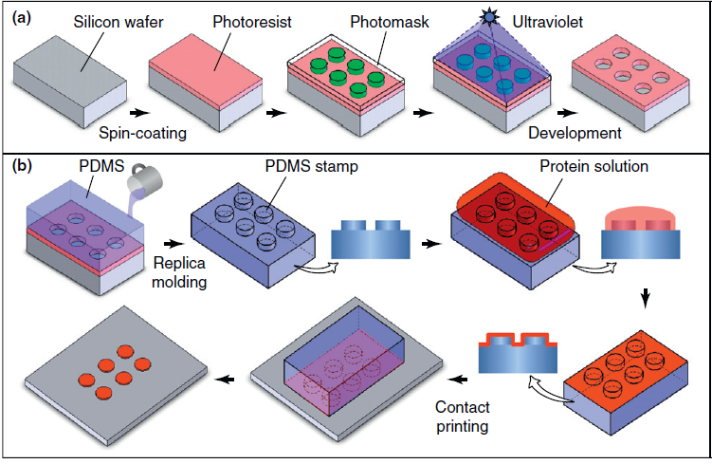
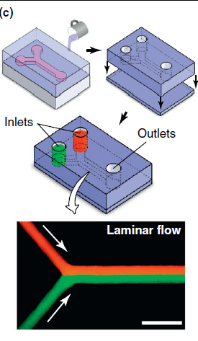
Microengineering technologies used to construct 3D culture systems and organs-on-chips
Photolithography
silicone rubber poly(dimethylsiloxane) (PDMS)
Microfluidic devices
Soft lithography

Slide 45
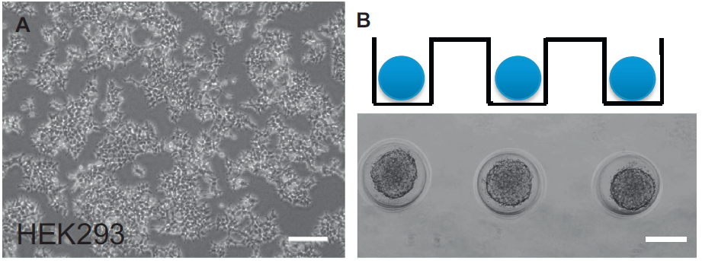
Es posible controlar el crecimiento celular en la microescala
100 μm
Fig. 2. Examples of cell spheroids as the simplest andmost convenientmodel of 3D cell culture. A) Human embryonic kidney cells (HEK293) in 2D culture. B) HEK293 cells in suspensions added to non-adherent agarose molds of defined size to encourage cell–cell adhesion, resulting in spheroids of sizes defined by them old diameter.

Slide 46
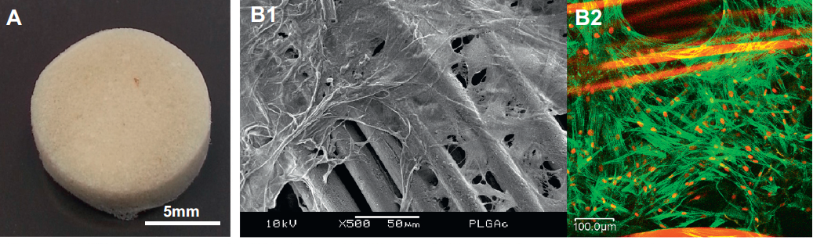
Matrices 3D mas comunes
A) A microporous sponge made from human hair keratins.
Scanning electron microscopy image of human dermal fibroblasts cultured on a 3D textile mesh made by knitting 20 μm fibers of poly(lactic-co-glycolic acid) (PLGA; 90:10).
Confocal laser microscopy image showed that the fibroblasts anchored well onto the PLGA fibers. green: F-actin; red: PLGA (fibers) and cell nuclei (elliptical spots).
Advanced Drug Delivery Reviews xxx (2014) xxx–xxx Probing the relevance of 3D cancer models in nanomedicine research☆
David T. Leong a,⁎,1, KeeWoei Ngb
Fig. 3. An overview of representative scaffold-based 3D cell culture systems. C) L929mouse fibroblasts suspended in a human keratin hydrogel proliferated over 3 days to formmulti-cell clusters. D1)Macroscopic viewof a 3D organotypic skin culture assembled by culturing keratinocytes on a fibroblast-populated collagen disc and exposed to air. D2) Histological assessment of a skin organotypic culture, showing normal anatomical arrangement of the epidermis and dermis. (For interpretation of the references to color in this figure legend, the reader is referred to the web version of this article.)

Slide 47
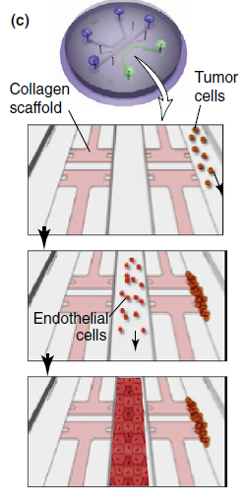
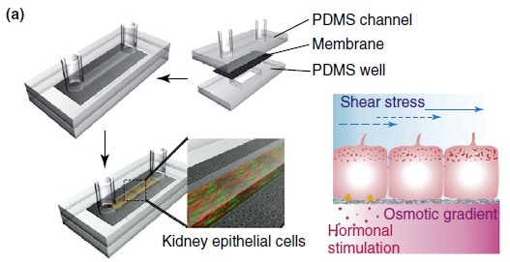
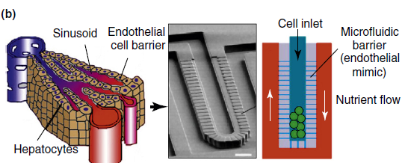
Organos-on-chips: miniaturizacion, integracion y bajo consumo + control multiparametros: gradientes quimicos rol, fluid shear stress, cell patterning, interfase tejido-tejido, interacciones organo-organo : imitando microentono fisiologico/patologico de organos humanos
Interaccion heterotipica
Riñón en un chip
Hígado en un chip
Figure 2. Microengineered organs-on-chips. (a) A microfluidic kidney epithelium model composed of a multilayered microdevice that incorporates stacked layers of PDMS microchannels and a PDMS well separated by a porous polyester membrane. The 3D architecture of this microsystem provides physiologically relevant culture environments for polarized kidney epithelial cells, and enables precise control of fluid flows, selective exposure of the apical and basal sides of the cells to fluid shear,
hormones, and chemical gradients, and collection of samples from both sides of the polarized tissue. (b) A microengineered liver-on-a-chip reconstitutes hepatic microarchitecture. The functional unit of this microsystem consists of a central liver-cell culture chamber and a surrounding nutrient flow channel separated by microfabricated barrier structures patterned with a set of narrow (2 mm in width) microchannels that mimic the highly permeable endothelial barrier between hepatocytes and the liver sinusoid. This biomimetic device closely approximates transport of nutrients and waste products in the liver sinusoid and provides more favorable environments for the maintenance of primary liver cells in a differentiated state (scale bar, 50 mm). (c) Heterotypic interactions between tumor cells and endothelial cells are studied in a microfluidic device that permits co-culture of these cells in two separate microchannels connected via scaffold channels filled with 3D collagen gels (pink channels in the diagram). This microfluidic system is used to model the tumor microenvironment and gain better understanding of important disease processes such as angiogenesis and cancer cell invasion during cancer progression. Reproduced from [50,55,60,61] with permission.

Slide 48
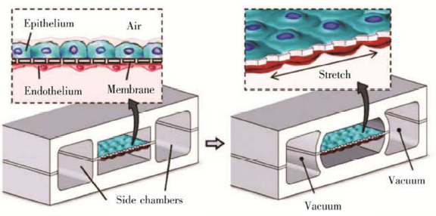
Pulmon en un chip
Organs‐on‐chips and Its Applications. SUN Wei1, CHEN Yu-Qing, LUO Guo-An, ZHANG Min, ZHANG Hong-Yang, WANG Yue-Rong,HU Ping. CHINESE JOURNAL OF ANALYTICAL CHEMISTRY Volume 44, Issue 4, April 2016

Slide 49
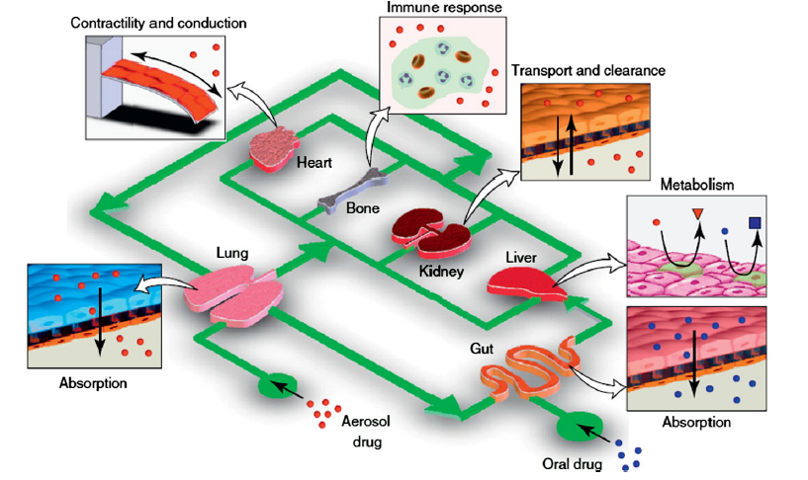
The human-on-a-chip concept: sistema integrado
Trends Cell Biology, 21, Huh, D.; Hamilton, G.A.; Ingber, D.E., From 3D cell culture to organs-on-chips, Pages No. 745–754, © (2011), with permission from Elsevier. 4 E.L. da Rocha et al. / Materials Science and Engineering C xxx (2013) xxx–xxx

Slide 50
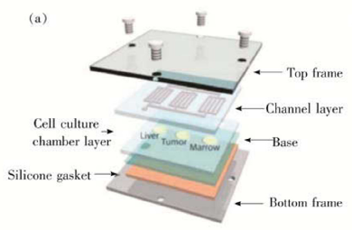
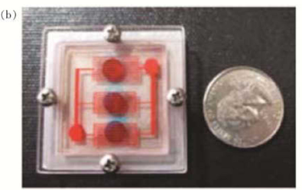
Fig.3 A multi-organ microfluidic framework[59]
a. Schematic of layered multi-organ chip; b. Picture of the assembled device
Organs‐on‐chips and Its Applications. SUN Wei1, CHEN Yu-Qing, LUO Guo-An, ZHANG Min, ZHANG Hong-Yang, WANG Yue-Rong,HU Ping. CHINESE JOURNAL OF ANALYTICAL CHEMISTRY Volume 44, Issue 4, April 2016

Slide 51
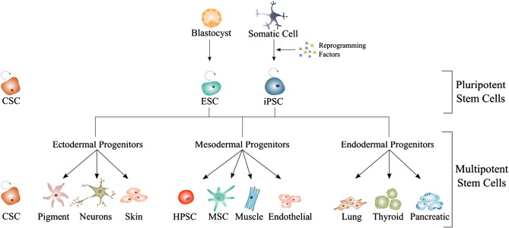
Ingenieria de tejidos/regeneración de organos
Problema ético: origen de las stem cells
Embriones humanos
factores de reprogramacion
Stem cells embrionarias
Induced Pluripotent Stem cells
Las iPSC son células adultas “obligadas a rejuvenecer”
Ingenieria de tejidos/regeneración de organos
Reprogramación celular: volviendo atrás el reloj

Slide 52
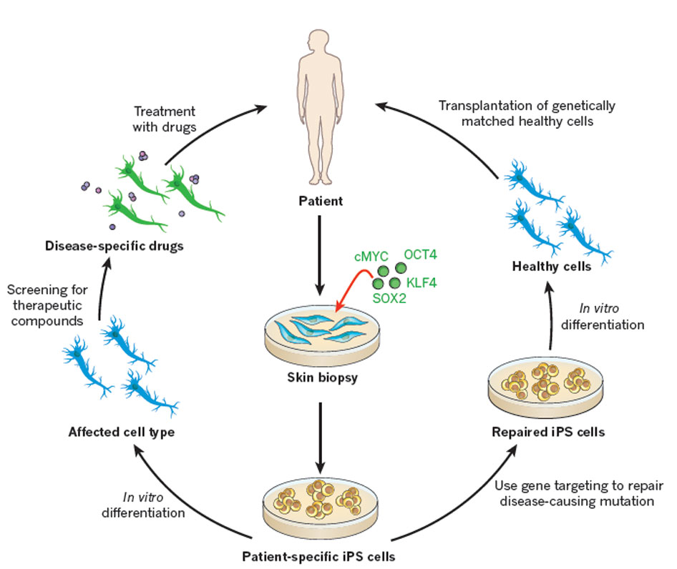
Reprogramación celular: volviendo atrás el reloj
Las iPSC son células adultas “obligadas a rejuvenecer”

Slide 53
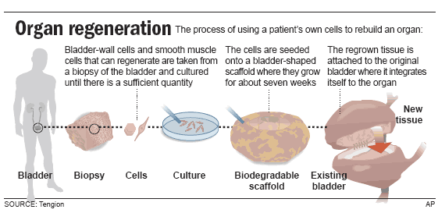
Regeneracion de órganos: necesidad de un “armazón” (scaffold) para las celulas
Nano!

Slide 54
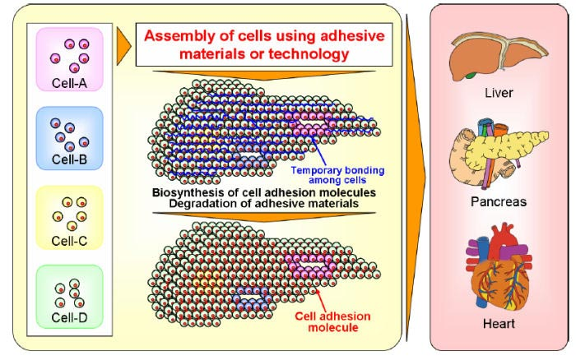

Regeneracion de órganos: necesidad de un “armazón” (scaffold) para las celulas
Nano!
Nano!

Slide 55

Nano!

Slide 56
Nanobiotecnologia: un nuevo paradigma en terapéutica

Slide 57








Terapéutica basada en pequeñas moléculas
acido acetil salicílico
doxorubicina
anfotericina B
enalapril

Slide 58



Terapéutica basada en pequeñas moléculas

Slide 59

Terapéutica basada en pequeñas moléculas
Ausencia de selectividad: efectos colaterales pueden ser mortales

Slide 60

Terapéutica basada en productos biológicos
Mayor complejidad estructural. selectividad
Tomado de IFPMA

Slide 61


Terapéutica basada en pequeñas moléculas o en productos biológicos: ¿que tienen en común?
Su PK/BD/TI/actividad depende de estructura
primaria-secundaria-terciaria

Slide 62

Nanomedicinas: un nuevo paradigma terapéutico
+
API (ingrediente farmacéuticamente activo)
= nanomedicina
Nanomedicinas: farmacocinética, biodistribucion y trafico intracelular [actividad terapéutica] independientes de estructura del API y dependientes de estructura del nano-objeto
Nano-objeto: 1,2,3 dimensiones en la nanoescala
3 dimensiones= nanopartícula

Slide 63

nanoescala

Slide 64

Nanomedicinas: un nuevo paradigma terapéutico
tratamientos menos tóxicos (selectivos), mas cortos, ¿mas eficaces?

Slide 65


